Slide 1

Social Network Analysis Day 2
Advanced Winter School in Computational Social Science
Carl Nordlund Maël Lecoursonnais Kazuki Sakamoto

Slide 2

Day 2: Monday 8th Dec
Comparing networks (QAP)
Network null models: rewiring, configuration models, backboning
Simulations
Relations and nodal attributes: introduction to network dynamics
Research design considerations

Slide 3

Comparing networks
If there is a tie between two actors in one type of relation, is there likely to also be a tie between them in another relation?
If two countries exchange ambassadors, will they trade more?
Do reported friends share information with each other?
Is inter-personal dislike inversely related to liking each other?
Do we seek advice from those we trust?
Quadratic Assignment Procedure (QAP) correlation/regression Knoke & Kuklinski (1982); Knoke & Wood (1981)
For multiplex networks:
One set of actors/nodes
One or more set of relations

Slide 4

Knoke Bureaucracies
Data collected by Knoke & Wood in 1978 from workers at 95 organizations in Indianapolis (Knoke & Wood 1981)
Respondents indicated with which other organizations their own organization had any of 13 different types of relationships
A subset of 10 organizations and two relationships (Knoke & Kuklinski (1982)
Money exchange (knokm.txt)
Information exchange (knoki.txt)

Slide 5
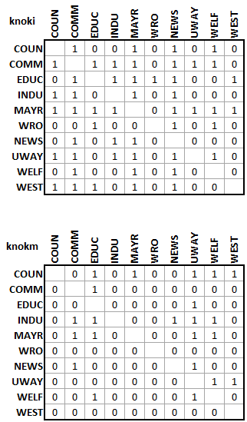
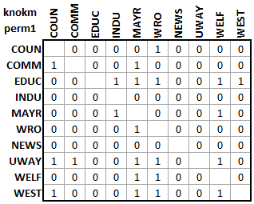
QAP Quadratic Assignment Procedure
Simple cell-wise correlation
Observed correlation: -0.051
Significant?
Dyadic data: observations are interdependent
Enter QAP: permute and recalculate! Repeat N (1000+) times

Slide 6
QAP Quadratic Assignment Procedure
Observed cell-wise correlation: -0.051
Average correlation from permuted data: 0.0016 [-0.466; 0.417]
p value (probability of getting a correlation < -0.051 in permuted data)
0.41: i.e. quite probable, so quite insignificant

Slide 7

QAP Quadratic Assignment Procedure
Estimating significance by random reshuffling
Law of Large Numbers: do a lot of permutation tests
Alternatives:
QAP regression
MR-QAP (multi-relational) regression
Krackhardt (1988): Sampson monastery data
Total of 8 social relations

Slide 8

EIES: pre- and post-conference
Added EIES friendship nominations at end of conference
eies_t2.txt
Average friendship increased from T1 to T2
T1: 1.33
T2: 1.63
QAP correlation: 0.809
Expected corr. from permutations: 0.001 [-0.221; 0.245]
p-value: 0.000

Slide 9

‘Null’ (reference/benchmark) models
When we observe a particular network with certain features:
How likely is it to be as it is?
How to determine whether empirical observations are meaningful?
…or if outcomes of chance alone?
Ways to generate reference networks (a.k.a. null models)
Typically dyadic interdependence (as with QAP)
Useful starting reference: Hobson et al (2021): https://onlinelibrary.wiley.com/doi/full/10.1111/brv.12775

Slide 10
Rewiring
b
d
Randomly pick an edge a → b
Randomly pick another edge c → d
Make sure that:
a is not connected to d
c is not connected to b
Rewire:
Remove a → b, and c → d
Add a → d and c → b
Repeat from 1 for N (>1000) times
a
c

Slide 11
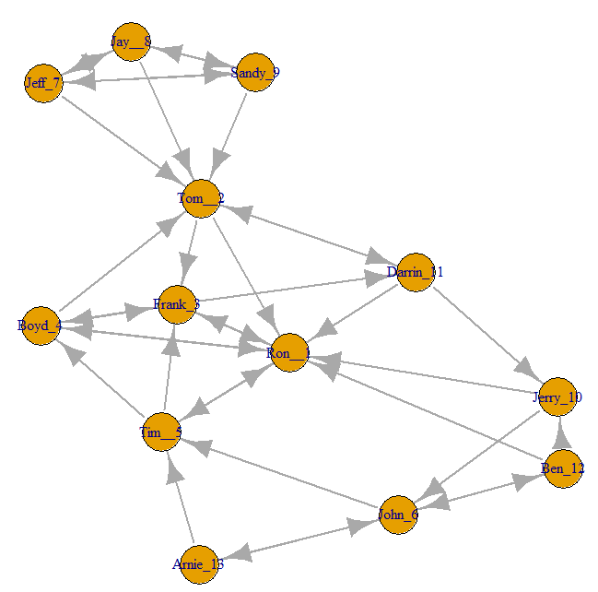
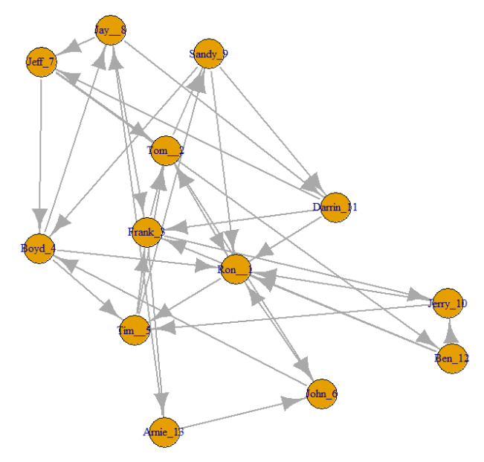
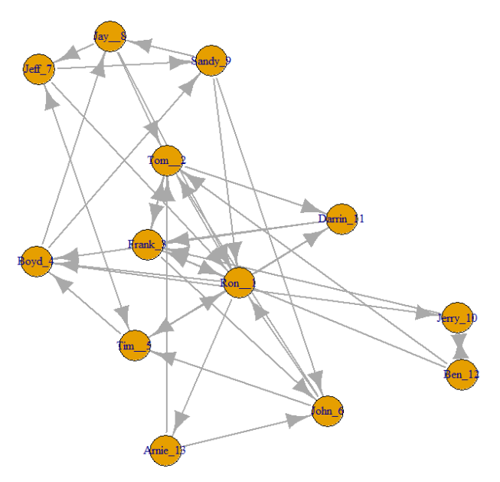
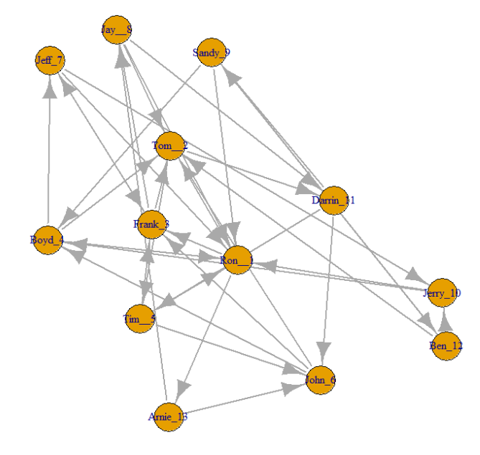
Rewiring
Given one observed network
Rewiring generates multiple random networks
Properties of these random networks
Same density
Same degree distribution (both in- and outdegree)
These random networks can be seen as potential counter-factuals
Determine average macro-level properties for these to compare with observed network
Determine assortative mixing, community structures etc.
Igraph:
rewire(g,with = keeping_degseq(loops=FALSE,niter = 500))

Slide 12
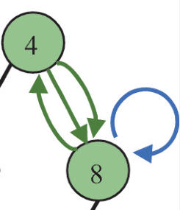
Configuration model
Similar to rewiring
Starts off with the degree sequence
I.e. assign a degree k_{i} to each node, typically from observed data
Remove all edges
Nodes filled with stubs
Could be directional stubs
Randomly pick two stubs and connect them
Continue randomly picking stubs until none left
Even though original network is binary and without self-ties, random network could contain both self-ties and multi-edges!

Slide 13
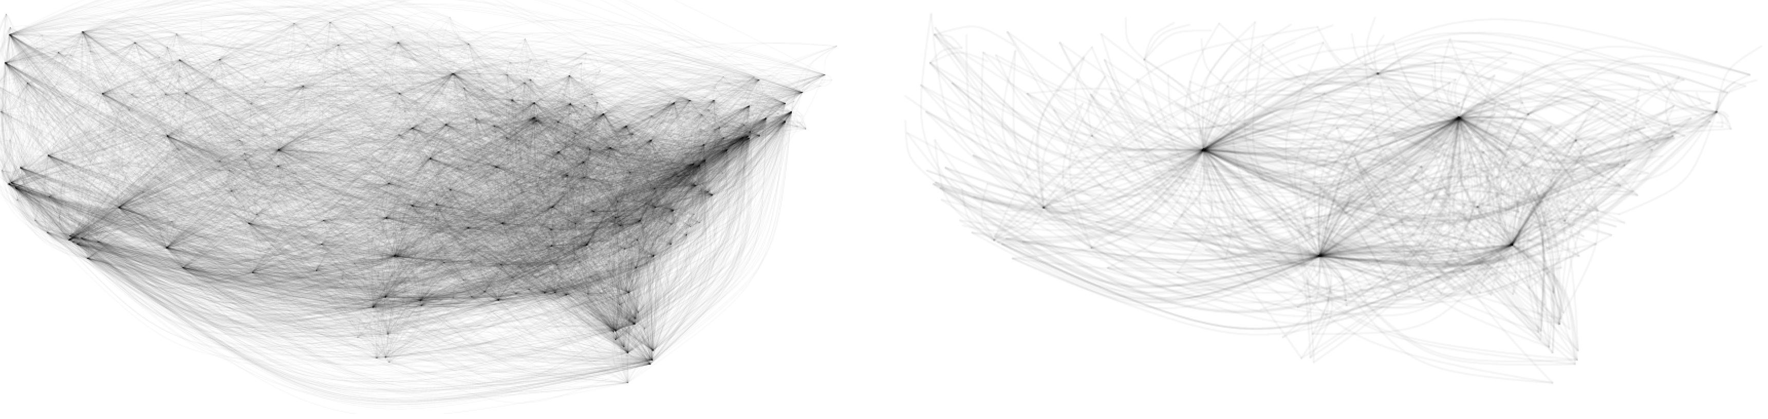
Backbone extraction
Family of methods for extracting most relevant relations in dense and/or valued networks
Also for bipartite (2-mode) networks
R package: backbone (Neal 2022)

Slide 14

Valued networks
Where relations have values/weights attached to them
Methods for valued networks
Blockmodeling (direct correlation-based, indirect)
Some centrality indices
Community detection (infomap)
However, most network methods for binary networks
Desire to convert valued networks to binary counterparts
Rudimentary approach: dichotomization
But where to set the threshold?
What is a prominent tie?

Slide 15
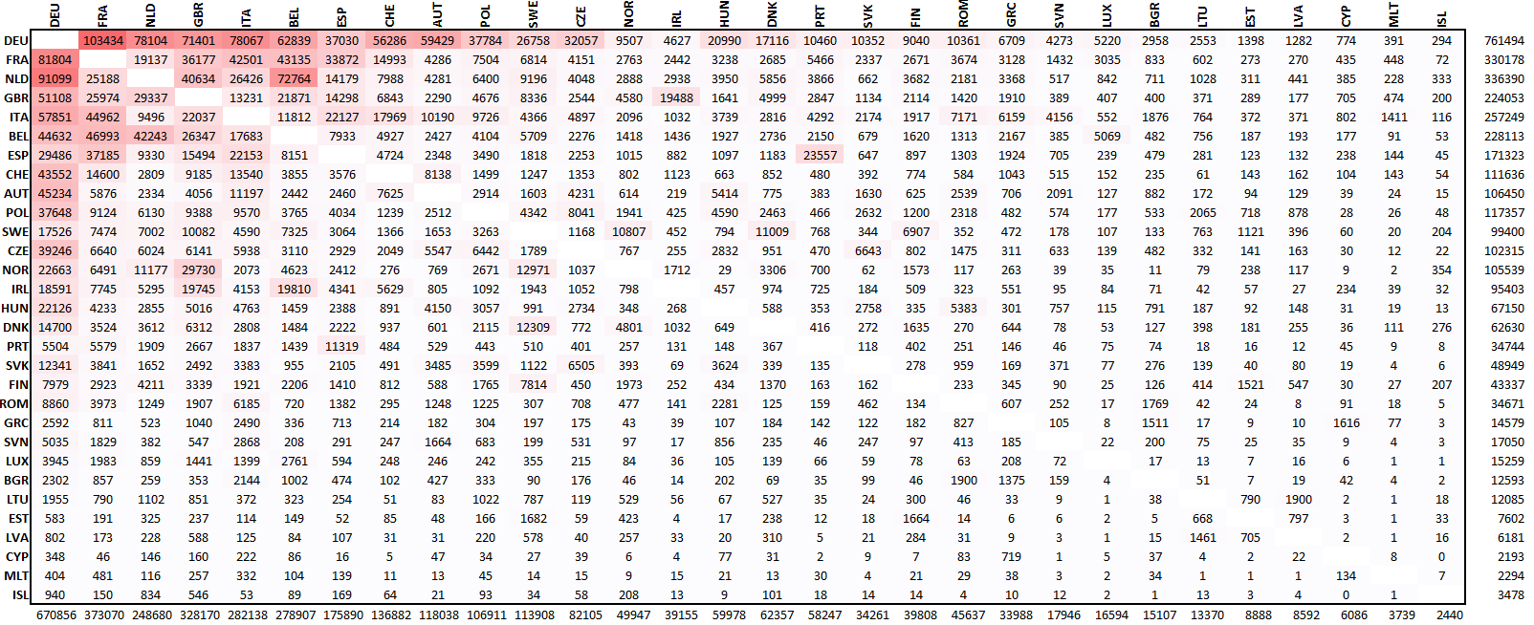
Valued networks
Similar relational capacities?
Likert-scales
Friendship nominations (EIES)
Notesharing (Hlebec)
Allocation-style
Minutes spent during lunch break
Rank ordering
Non-restrained
International trade flows
Iceland’s largest import (333) is smaller than Germany’s smallest import (348)

Slide 16
Valued networks Unequal relational capacities
Transaction flow model (Savage & Deutsch 1960)
Relative acceptance index
Contingency table approaches
Iterative row-column normalization (e.g. Schwartz 1977)
Sums of rows and columns converge to unity
Dichotomize these
Deviational transformation (Nordlund & Žiberna 2020)
Determine baseline model for valued networks
Positive deviations from such baselines indicate prominent (binary) ties

Slide 17

Simulation-based null models
When tie formation mechanisms and behaviors are reasonably understood
Using custom-made simulations do generate counterfactual networks
Determinants for tie formation and rewiring
Contextual knowledge/insights
Theoretical considerations
Attributes of observed actors

Slide 18
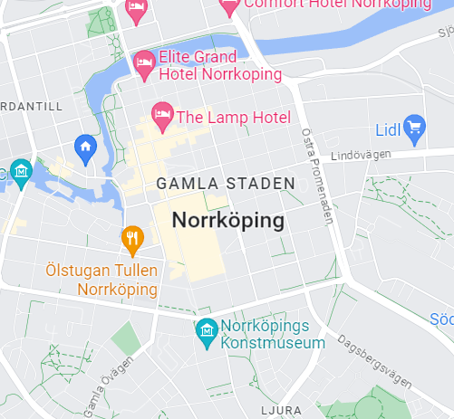
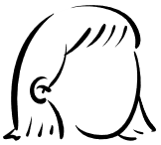



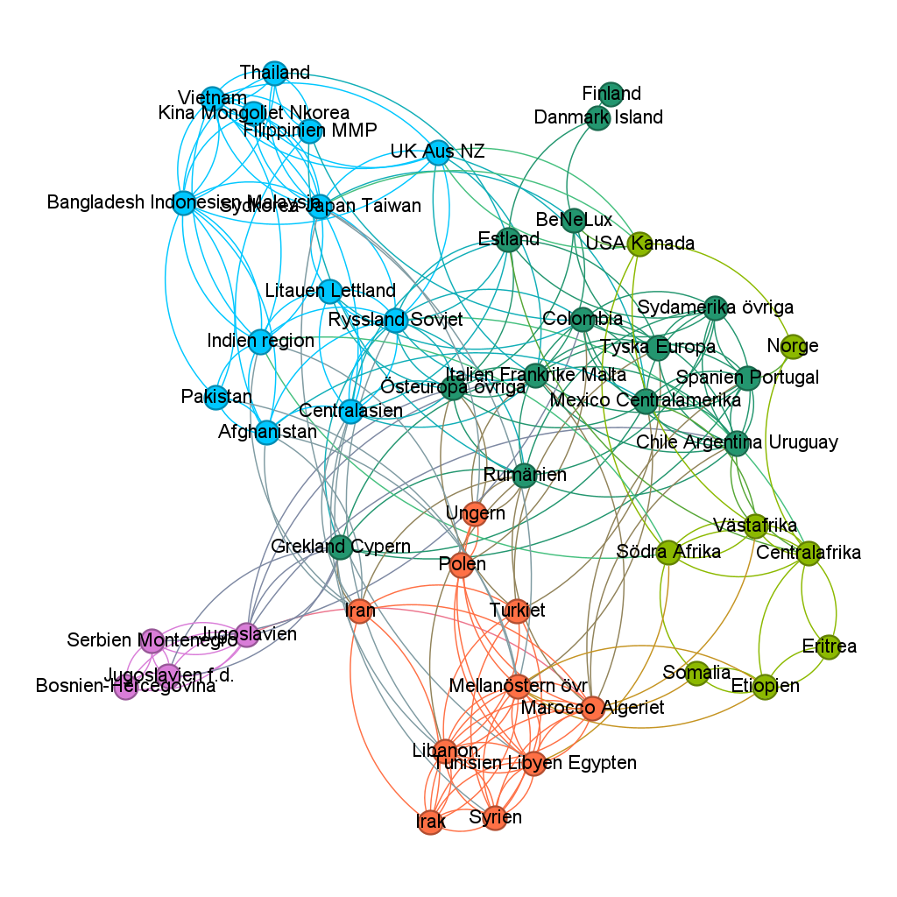
Example: Alternative family formation events (Lindmarker & Nordlund, ongoing)
Given existing set of geolocated heterosexual couples (prior to moving in together)
For each individual, compile a set of potential partners
Centered around the X,Y coordinate of actual partner
Potential partner ages: +/- 2 years of actual partner (reciprocated)
Overlapping activity period (5 years)
Generate new families
Collapse into intra- and inter-group networks
Generate 100+ simulated networks
Compare with original observed network

Slide 19
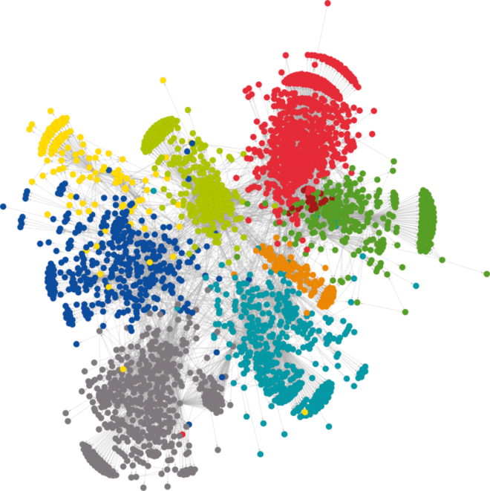
Relations and nodal attributes: Introduction to network dynamics (stolen from David Garcia)
Assortativity
Similar nodes more likely to be connected than dissimilar nodes
Assortativity coefficient
But what generates assortativity?
Homophily
Contagion
Confounding

Slide 20
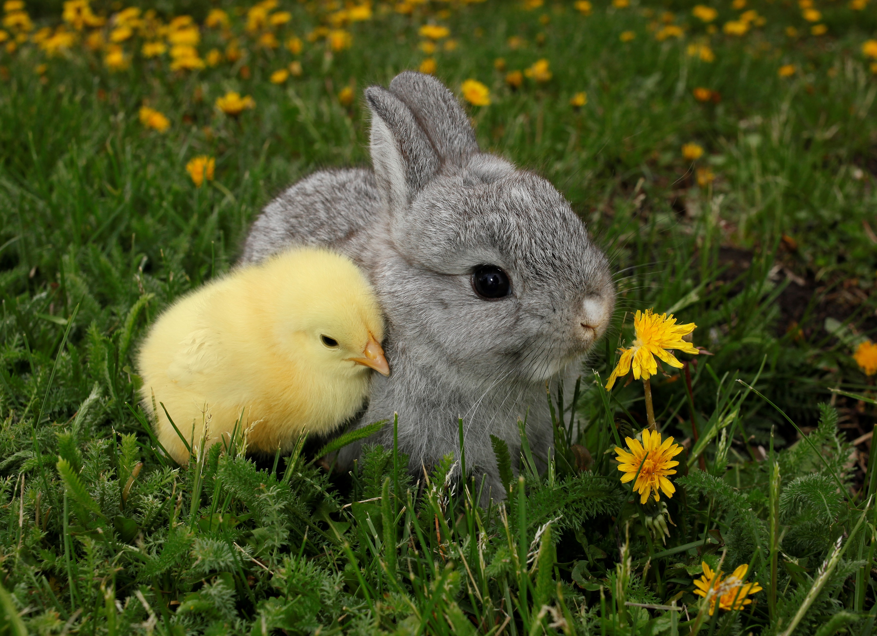
Homophily
Tie formation
Individuals more likely to form social ties to individuals that are similar
“Similarity breeds connection”
Attributes (e.g. gender, opinions etc) begets ties
Selection
Birds of a feather flock together (McPherson et al 2001)

Slide 21

Contagion
Change of attributes
Individuals are influenced by their social surroundings
Adopting behaviors of their social contacts
Relations beget attributes
Influence
Contagion (e.g. Centola 2007; 2018)
Simple (epidemic-style)
Complex (needs more than one alter influence)

Slide 22

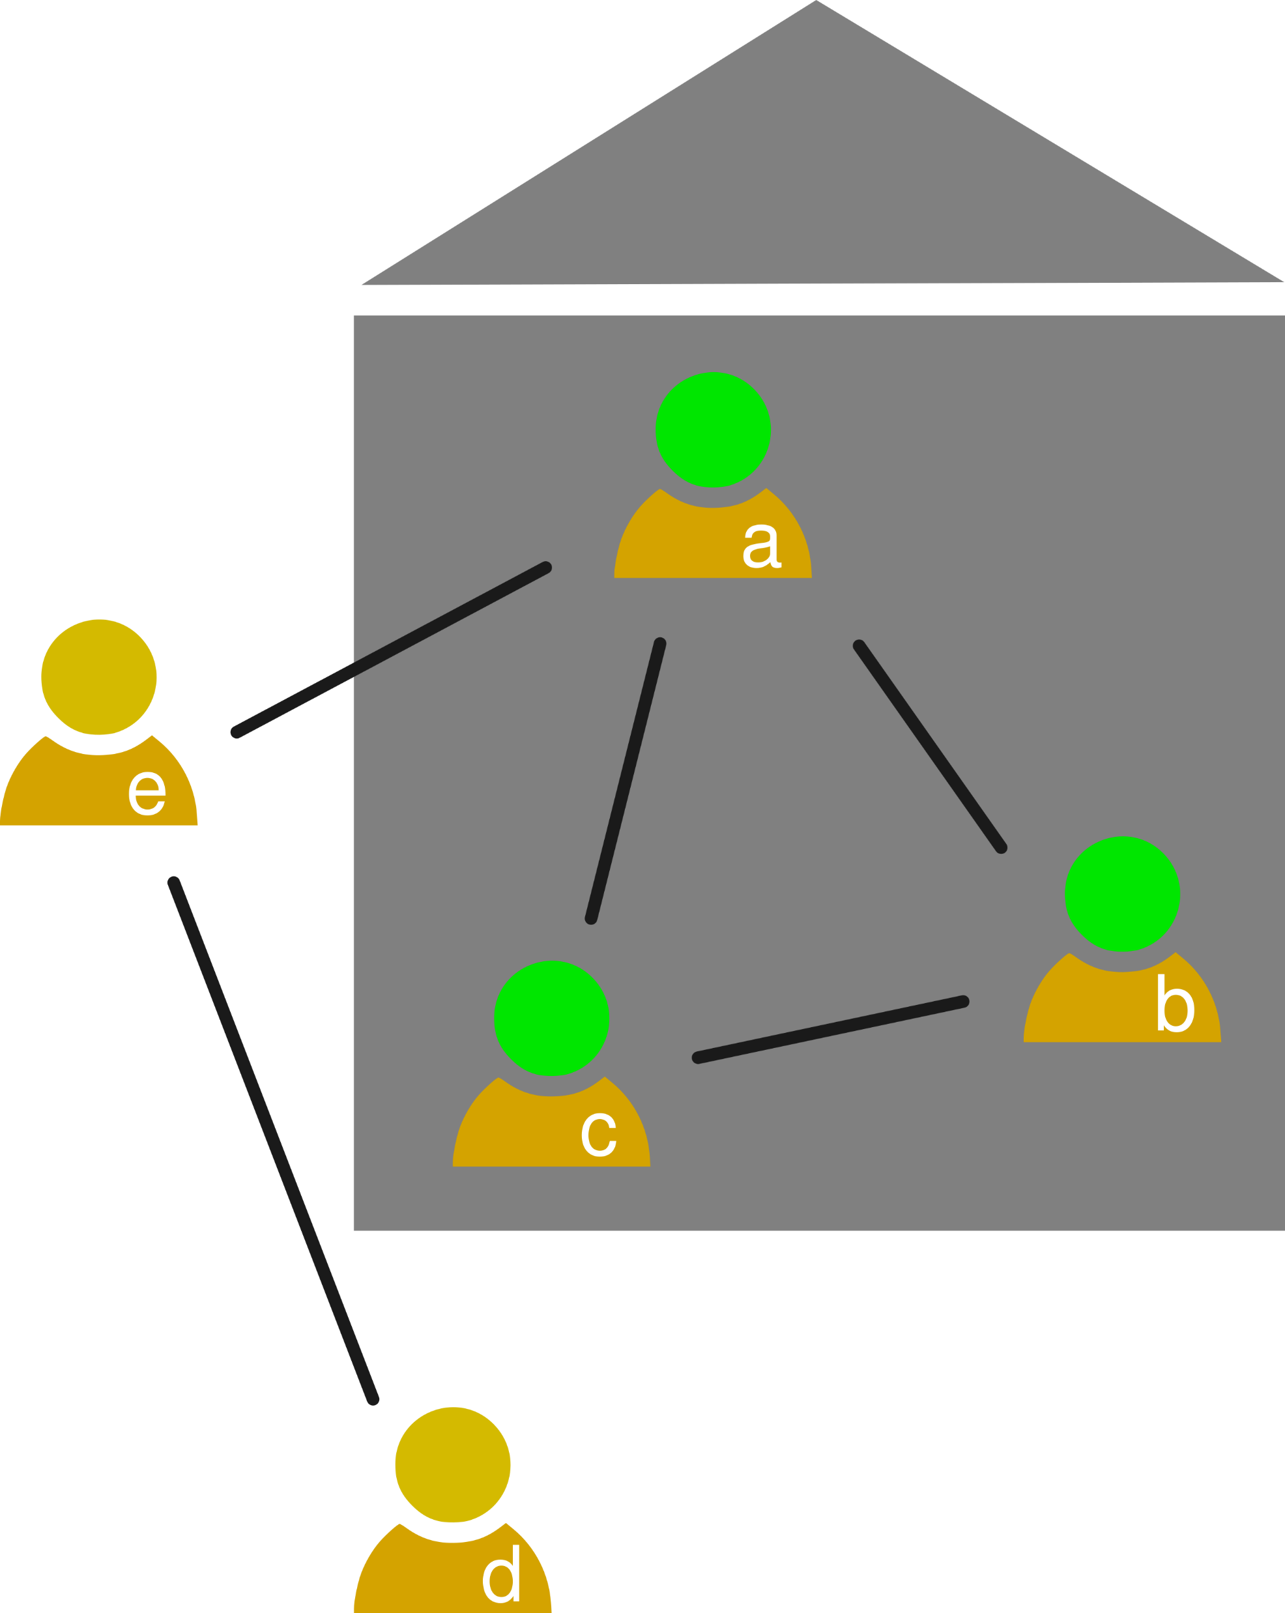
Confounding
External effects can produce both tie formation and attributional change
No causal relationship between relations and attributes
A third cause!

Slide 23

Disentangling choice vs. influence
Typically requires more than a simple snapshot
Longitudinal data preferable

Slide 24
Social Network Analysis and CSS
Computational Social Science
Research question
Methods
In CSS, we tend to start off with the RQ cog
Building on previous research, we formulate RQs of social-scientific and/or societal relevance
Is GDP growth linked to positionality in trade networks?
Are central NGO’s more efficient than less central ones?
Are inter-ethnic families happier than endogamic ones?
To address these: pair up methods with data
Circling back to RQ at the end
Data

Slide 25
Social Network Analysis and CSS
Research question
Methods
Postulating that data science is more exploratory
Given (typically large and complex) datasets
More exploratory, open-minded approach
Apply methods to prune out insights data
Although general topic area given by the data
Perhaps more open to finding signals
Seed to an interesting research question
Formulating question (or topic)
Connecting with previous research
Data Science
Data

Slide 26
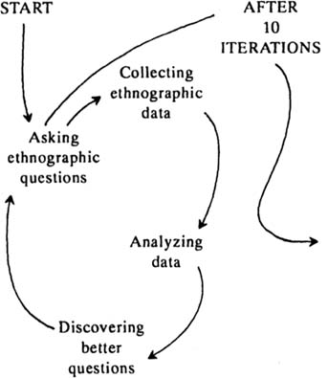
Social Network Analysis and CSS
Ethnographic cycle (Gladwin 1989)
Ask ethnographic questions
Collect data
Analyze data
Discover better question (repeat from 1)
In context of CSS (and SNA)
Research question
Database, scraping, wrangling
Methods and analysis
Discover better questions (repeat from 1)
A potential ‘relational turn’!

Slide 27
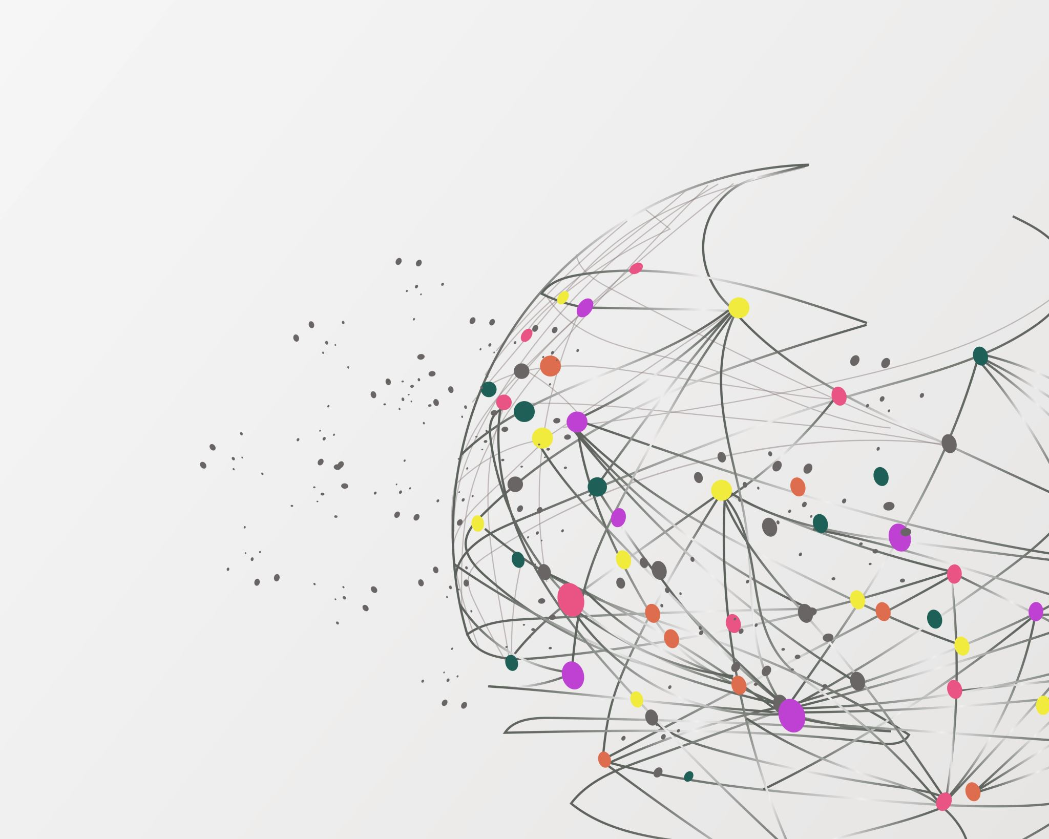
THANK YOU FOR YOUR ATTENTION TO THIS MATTER!
carlnordlund.net

